Slide 1
NIH NCI Internship
Andrew Liu

Slide 2
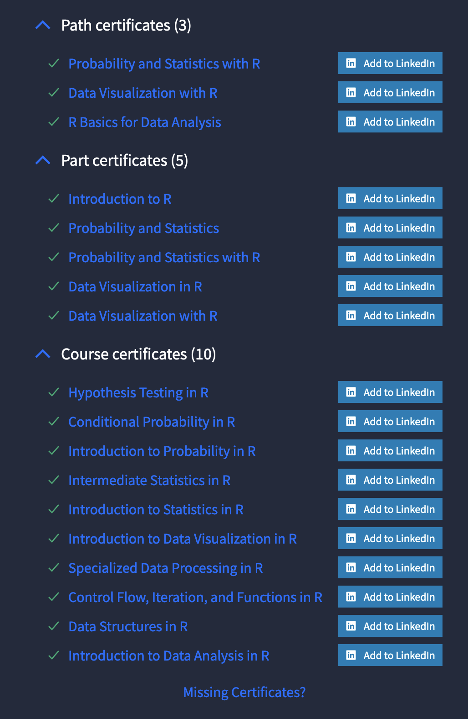
Initial
Reviewing R code and techniques
Reviewing statistical methods and models
Learning about project broad goals

Slide 3
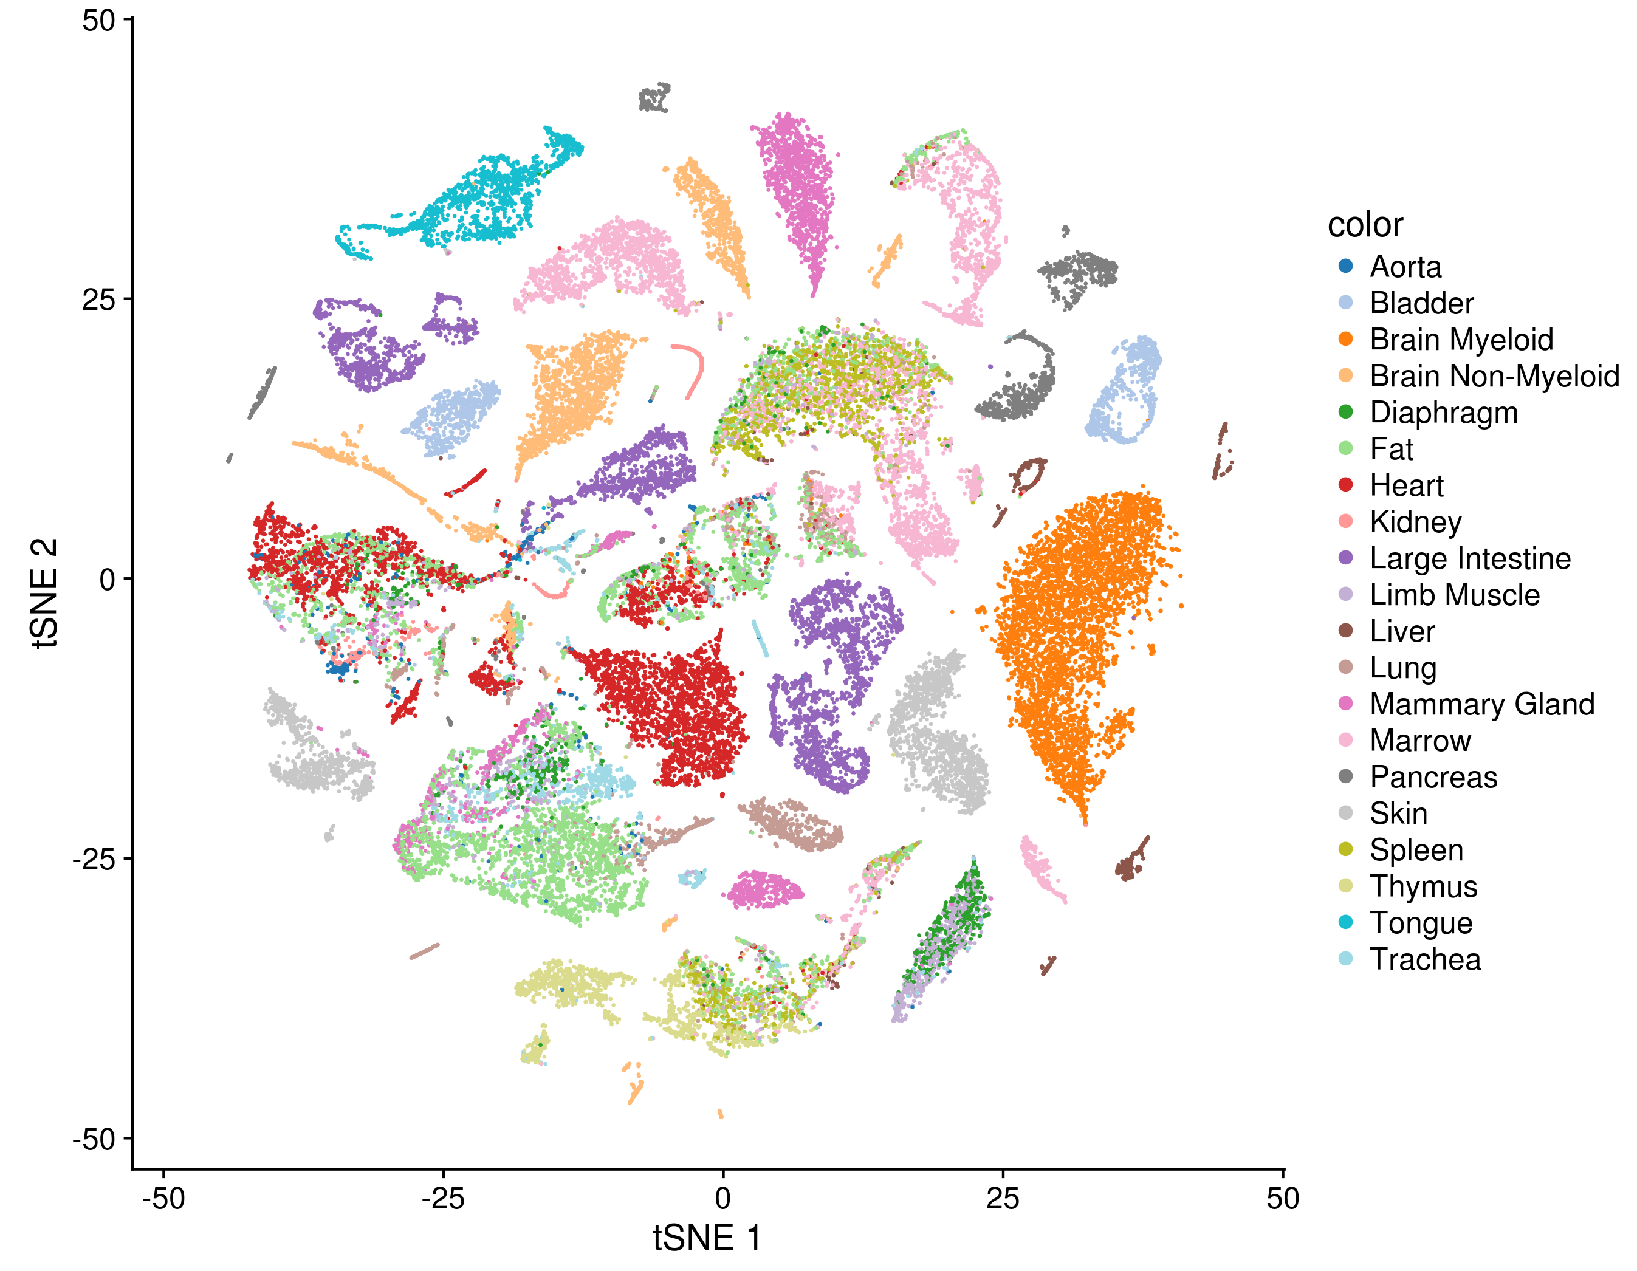
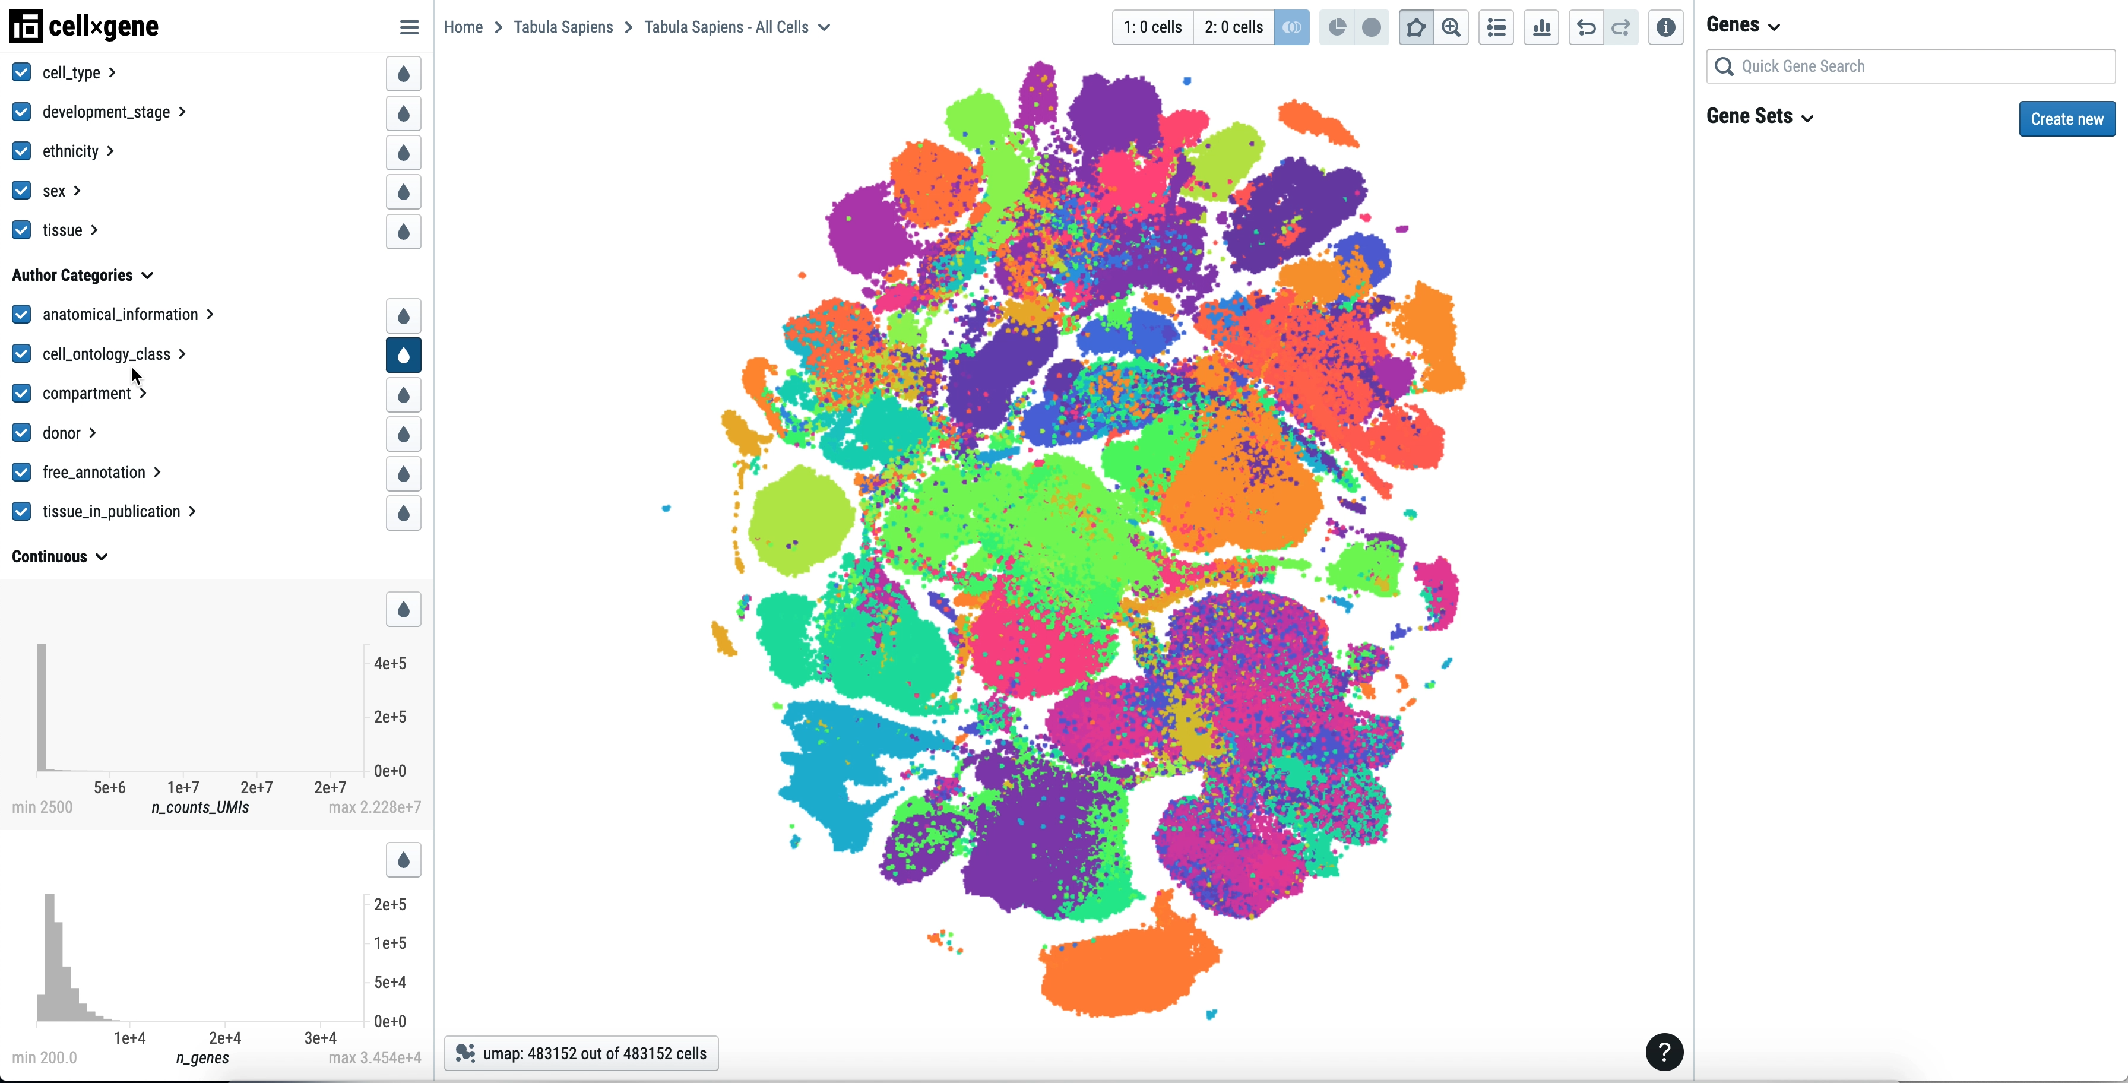
My Summer
Focused on Tabula Muris and Tabula Sapiens w/ comparison to scRNAseq data from Biomart

Slide 4
4 Main Outcomes
Learned how to take unprocessed data and clean it for analysis
Scan for empty cells, clean row names (ex: chromosome attachments), verifying gene IDs
Process Tabula Muris and Sapiens into ready to read .rds files
Learned how to make graphical representations of different comparisons
ViolinPlots, ScoreHeatmaps, DeltaDistributions, ScatterPlots
Learned how to access remote supercomputer using Terminal
Learned how to write .bash and .swarm files to automate running R scripts and Rmd in parallel

Slide 5
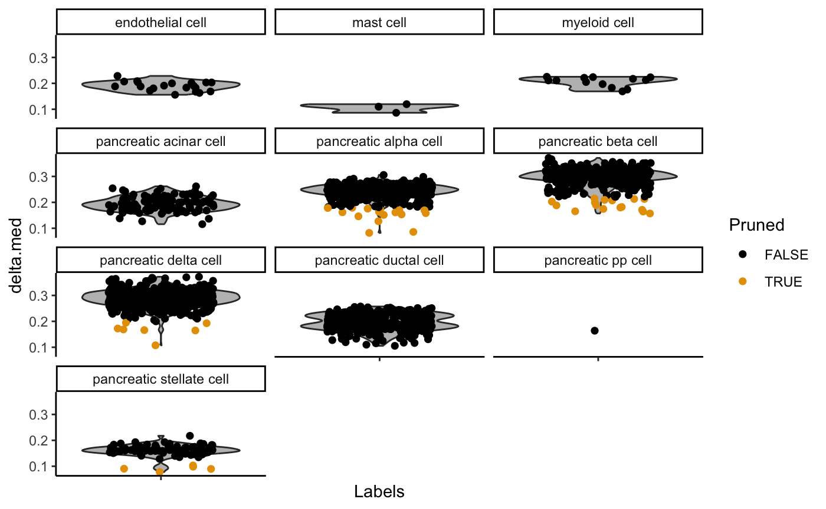
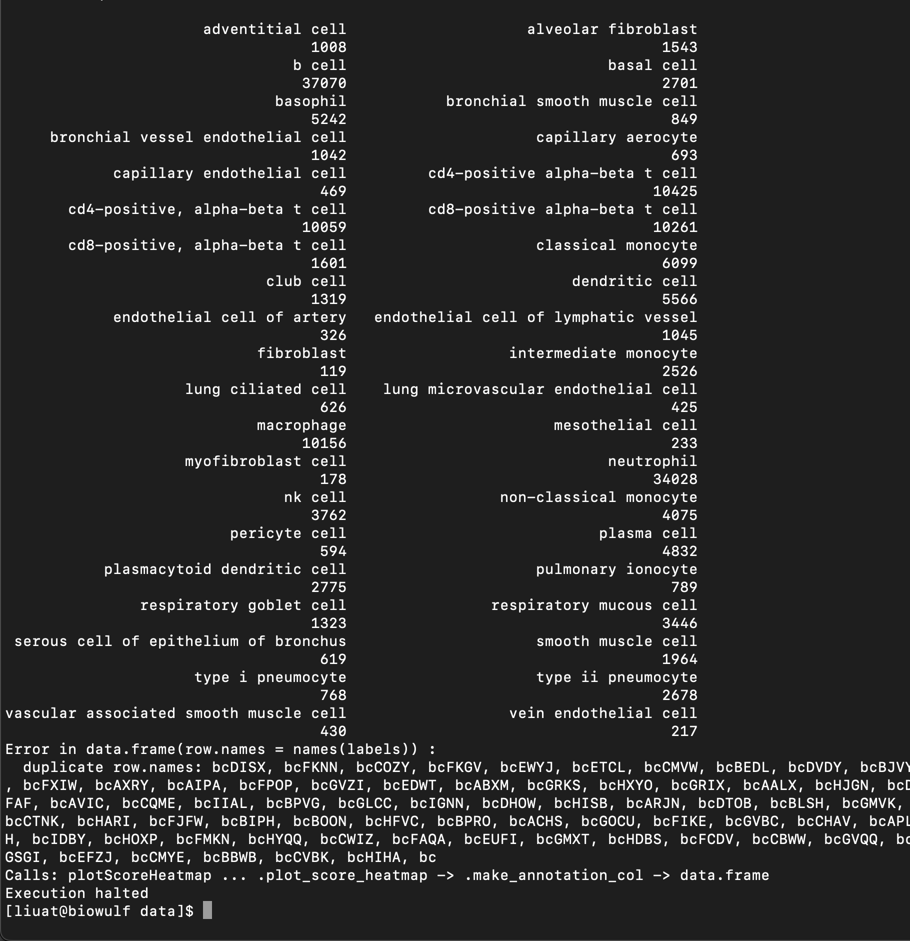
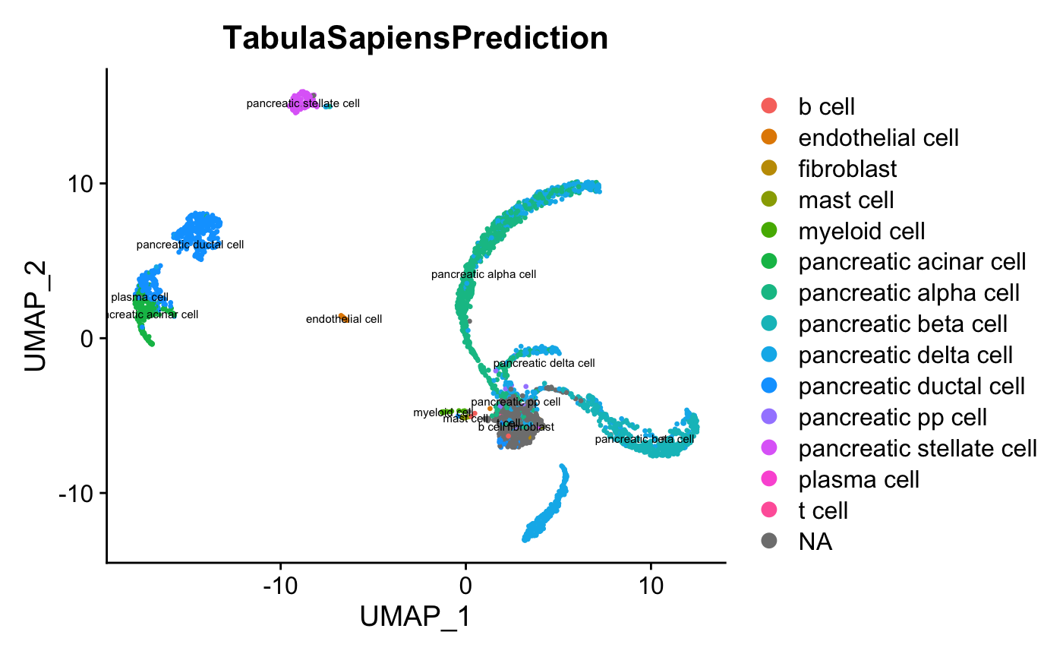
Output

Slide 6
Current Limitations in Knowledge
Bayesian Statistics
Biological Pathways past Biochemistry
Factors behind cell death

Slide 7
Internship Summary (brief)
My internship with the NIH this summer was fruitful and educational to say the least. Initially, I reviewed R coding techniques and statistical methods / modeling through Dataquest lessons courtesy of the NIH. These instructive modules helped me transition into learning about SingleR, Seurat, and SingleCellExperiment objects. After thoroughly exploring the Seurat tutorial and accessing Biomart for datasets, I was ready to tackle my summer project: run SingleR comparisons between Tabula Muris and Sapiens against corresponding organ data pulled from Biomart.
This project brought four learning outcomes. First, I learned how to take imperfect data and clean it for analysis. This included scanning and removing empty cells, verifying row name conventions, and confirming gene IDs. This step prevents many downstream errors and was important for me to pick up. Second, I learned how to make graphical outputs of many analyses. Although these functions are pre-defined, it was valuable learning about the parameters involved in various functions and preparing the data ahead of this step. Third, I learned how to access a remote supercomputer with Terminal. The Tabula datasets can be several gigabytes large and sometimes too cumbersome for a PC to process. The NIH owns a supercomputer named Biowulf that has the processing power to take on SingleR comparisons between datasets, each several GB large. To do so, remote access was needed and was done through Terminal. Lastly, I learned how to write .bash and .swarm files, which aided me greatly in processing the dozens of Tabula datasets. Similar R scripts and R Markdown files were applied to the Tabula datasets, so by running these in parallel through swarm files, the efficiency increased greatly. This helped me both with conversion of Tabula datasets to .rds files and running SingleR comparisons w/ additional graphical outputs.
My mentor Dr. Nathan Wong was instrumental in my successes and I couldn’t have accomplished nearly as much without him. He was an amazing guide at what he does, and when we hit the inevitable coding snag, he always helped me find a solution and learn how to troubleshoot. The internship was a great success and I’m proud to have worked with the NIH and Dr. Wong this summer.

